Slide 1
Annual Meeting of Shareholders
June 13, 2024
Tomorrow’s Tech Solutions…Today
Notes:
Welcome to the 36th Annual Meeting of Shareholders.
We appreciate your attendance.
Following adjournment of the formal meeting, management will provide highlights of the Company’s 2022 financial performance, a review of current business conditions and brief comments about 2023 first quarter results.

Slide 2
Meeting Agenda
Elect six directors of the Company, each to serve for terms expiring at the next Annual Meeting of Shareholders
John P. Gilliam Edward W. Ungar
Emily Lu Charles Wickersham
Laura F. Shunk Jeremiah R. Young
Ratify selection of independent registered public accounting firm for the year ending December 31, 2024.
Transact any other business which may properly come before the meeting or any adjournment thereof.
Tomorrow’s Tech Solutions…Today
Notes:
Our agenda is based on the proposals identified in the Proxy materials you received.
At this time, we will commence the formal part of today’s meeting.

Slide 3
Annual Revenue (2018-2023)
$ millions
$28.0
$23.5
Largest Customer
2018 36%
2019 72%
2020 75%
63%
73%
2023 78%
$13.0
$13.4
$11.4
$10.9
Tomorrow’s Tech Solutions…Today

Slide 4
Annual Net Income (2018-2023)
($ millions)
$1.7
2018 2019 2020 2021 2022 2023
* Income Applicable to Common Stock reflected annual Dividends on preferred stock of $24,152 for 2018-2021
Tomorrow’s Tech Solutions…Today
Notes:
Considerable progress has been achieved during the past 3 years regarding the Company’s revenue growth and profitability.
The 9% increase in 2023 first quarter revenue versus a year ago understates the extent to which higher volume more than offset lower raw material costs compared to a year ago.
Earnings per share benefited from higher revenue, gross profit and interest income, partially offset by higher operating and income tax expenses.

Slide 5
Cash and Investments (on December 31st)
($ millions)
2018 2019 2020 2021 2022 2023

Slide 6
Strategic Market Focus
Tomorrow’s Tech Solutions…Today
Tomorrow’s Tech Solutions…Today
Tomorrow’s Tech Solutions…Today
Notes:
SCI is active in several niche markets of the estimated $600 billion global photonics industry.
We currently manufacture technically advanced products and provide valued services to the automotive, defense, aerospace and other customers in the photonics industry.
Our increased capabilities, benefiting from IP and in-house expertise developed over more than 3 decades, enables us to serve additional niche markets as long-term opportunities emerge.

Slide 7
Research and Development Initiatives
“Stoichiometric Engineering of Rotary Metal Oxide Targets for Thin Film Applications: A Focus on Zinc Oxide Based Alternatives”
Presented by Jing Yang, PhD.
Sr. Product Development Engineer
International Conference on Metallurgical Thin Film Coatings
San Diego, California
May 2024
7
Tomorrow’s Tech Solutions…Today
Notes:
SCI’s R&D focus is on opportunities that leverage SCI’s expertise in compatible niche markets and accelerating time-to-market.
In-house knowledge concerning optical and electrical properties benefits achievement of innovative product solutions and new applications through collaboration with customers.
The subject of Jing’s poster, shown on the left side of this slide, is “Repressing Noble Metal Ruthenium Target to Reduce the Cost of Bipolar Plate Manufacture in Fuel Cells.”

Slide 8
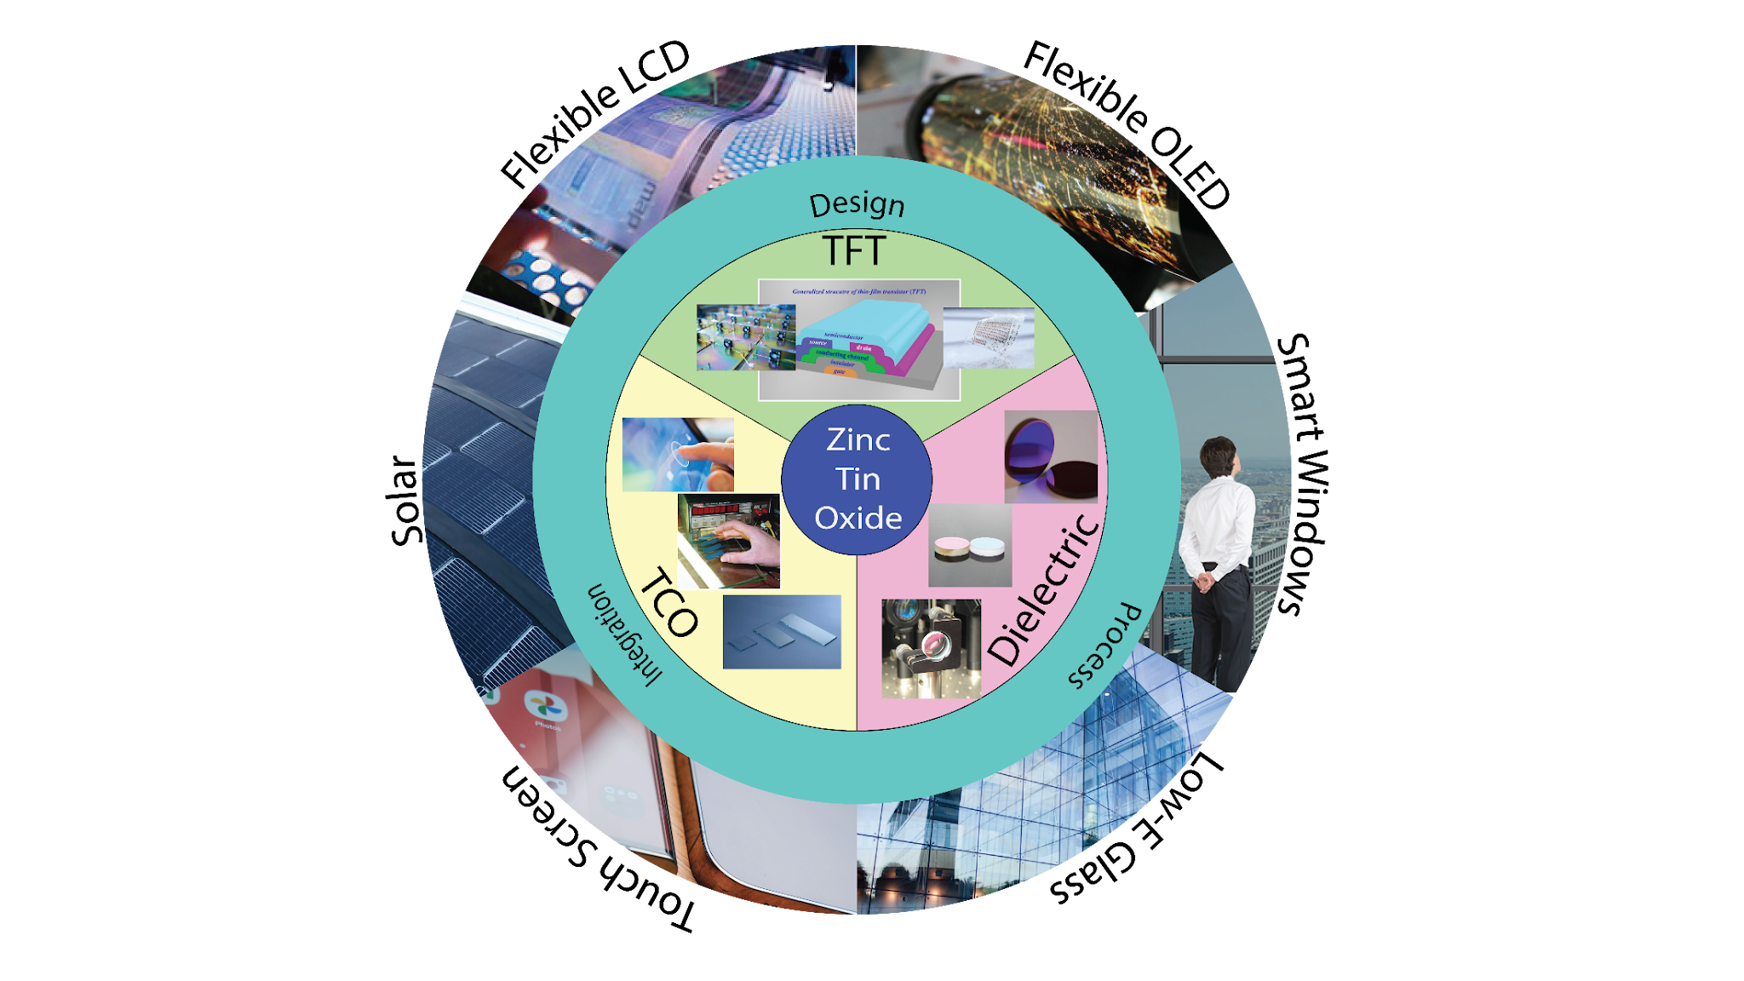
Zinc Tin Oxide Market Opportunities
The Company is investing in development of new applications which include:
Electrically conductive Zinc Tin Oxide
Sputtering targets for transparent electronics
Custom powder solutions
Electrically conductive Molybdenum Oxide material
Additional vacuum hot pressing applications
SCI has a patent for specific technology that protects the Company’s processes used in achieving superior bonding for rotatable targets.

Slide 9
Exhibitor at Six Industry Trade Shows in 2024
January 31-February 2
April 21-25
May 6-9
May 15-24
June 24-27
August 18-22
Tomorrow’s Tech Solutions…Today
Notes:
Last year we participated in four industry tradeshows as shown on the left side of this slide. In 2023 we are increasing that number to six to further increase our corporate visibility and direct access to customers.
These increased activities, in addition to ongoing customer support and collaboration, led us to add an inside sales person last week.
A quick reference to Photonics West. It is the largest global conference which attracts customers from multiple segments of the global Photonics industry. Previously, we had attended this tradeshow; however, 2023 was our first year with a booth and that proved to be worthwhile.
Feedback from these tradeshows has led to many inquiries, new customers and stronger customer relationships.
.

Slide 10
ColdFIRE® Manufacturing Agreement
Unique, photoluminescent powder that provides a bright infrared glow that lasts for a full night cycle.
Easily incorporated into films, plastics, paints, coatings, and other materials to create innovative options for making clothing, tactical equipment, and machinery night vision optimized to support no-light/low-light missions.
Performs without batteries or electronics and rapidly recharges in natural or artificial light for continual reuse.
No incremental weight penalty and require no modification of the original form factors.
Tomorrow’s Tech Solutions…Today

Slide 11
Online Marketing Initiatives
Tomorrow’s Tech Solutions…Today
Tomorrow’s Tech Solutions…Today
Notes:
During the past several months we initiated several online campaigns directed toward specific industry groups, pertinent job positions and fields of study.
For example, as shown on this slide, these efforts include ads on LinkedIn which has proven to be a good platform for raising SCI’s visibility and raising customer interest.
Additionally, we use Facebook and Twitter to keep current and prospective customers informed about the Company’s events and related topics.

Slide 12
Social Media Outreach
Tomorrow’s Tech Solutions…Today

Slide 13
Questions & Answers
Tomorrow’s Tech Solutions…Today
Notes:
We now have a few moments to respond to questions before Board members and management need to exit for a scheduled meeting.

Slide 14
Thank you for attending SCI’s 2024 Annual Meeting of Shareholders
Tomorrow’s Tech Solutions…Today
Notes:
We appreciate your attendance at today’s meeting and continued support of SCI.

